Slide 1
ME759 High Performance Computing for Applications in Engineering [Spring 2020]
Lecture 25
03/27/2020
Dan Negrut, 2020 ME759 UW-Madison

Slide 2
The quote the day
“The best fighter is never angry.”
-- Lao Tzu [ballpark 6th to 4th century BC]

Slide 3
Things to do, for Canvas live-session
Dan: start the Canvas recording
Everybody else:
Please mute your microphone
Please ask questions (limit: two per person per lecture; after that, post on Piazza)
When you ask questions, first unmute your mic

Slide 4

Before we get going…
Last time:
Caches
Caches coherence & mechanisms to enforce it
False sharing
Optimization aspects
Today:
Optimization aspects, wrap up
Getting the ball rolling, distributed mem parallel computing with MPI
Other tidbits:
ME759 Exam: April 15, at 7:15 PM, in Canvas
Review: Tu, April 14, at 7:00 PM, in Canvas
Office hours moved to Canvas (same time/date)
Assignment 9 went out; due on Th, 9 PM
We’ll have 10 instead of 12 assignments
Final Project Proposal due tonight, 9 PM
MESI

Slide 5
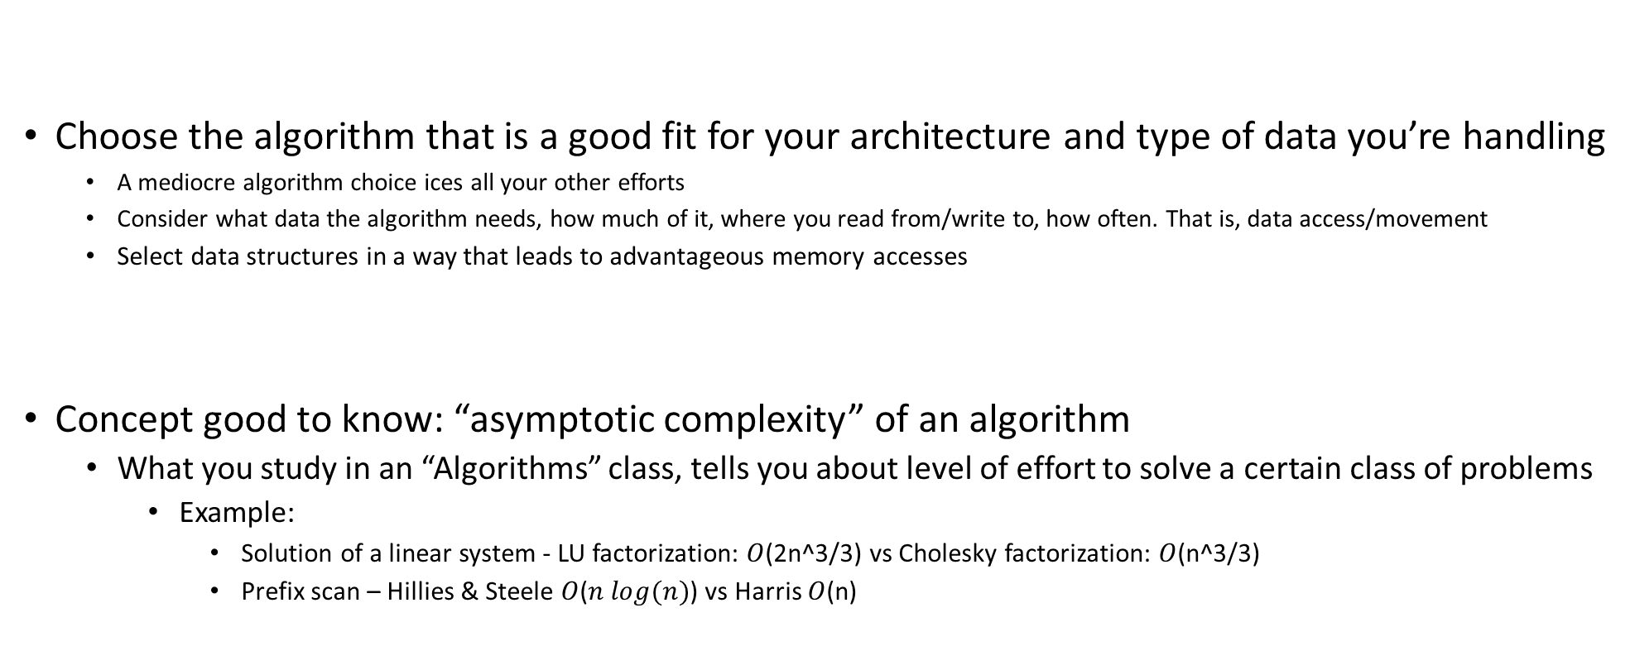
Starting off on the right foot: choose the right algorithm
Choose the algorithm that is a good fit for your architecture and type of data you’re handling
A mediocre algorithm choice ices all your other efforts
Consider what data the algorithm needs, how much of it, where you read from/write to, how often. That is, data access/movement
Select data structures in a way that leads to advantageous memory accesses
Concept good to know: “asymptotic complexity” of an algorithm
What you study in an “Algorithms” class, tells you about level of effort to solve a certain class of problems
Example:
Solution of a linear system - LU factorization: $O$(2n^3/3) vs Cholesky factorization: $O$(n^3/3)
Prefix scan – Hillies & Steele $O$($n log(n)$) vs Harris $O$(n)

Slide 6
Starting off on the right foot: choose the right algorithm
When working on problem, there’s more to performance than asymptotic complexity
Why?
Because asymptotic complexity is most often defined by number of operations
Memory transactions are rarely considered – they are specific to the hardware you’ll eventually use to run
If you understand how the computer works, it can guide you in designing a good/fast solution
Indeed, there is hope:
A problem can be solved by many algorithms (or approaches)
Also, one algorithm can have many implementations
NOTE: You should spend time reflecting on your solution before writing any line of code!

Slide 7
Asses the “Arithmetic Intensity” associated w/ your problem
Arithmetic intensity: how much math you do per byte of data you bring from memory
You can be in one of three cases:
Case 1: compute bound
That is, high arithmetic intensity – the ALU works a lot, not a whole amount of data movement to/from memory
Case 2: memory bound
You are moving data back and forth, likely only small parts of the data moved gets changed and/or used
Think cache misses
Case 3: “middle-earth” (J. R. R. Tolkien)
Somewhere in between compute-bound and memory-bound.
Your mission in this case: Try to move to Case 1 or Case 2 above

Slide 8
Arithmetic Intensity: Putting things in perspective
J. R. R. Tolkien’s “Middle-earth”
Memory bound
Compute bound
FLOP/Byte
SAXPY
FFT
SGEMM (matrix-matrix multiplication)

Slide 9
Simple Optimization Technique: Fusing Transformations
One way to move the needle from “memory bound” towards “compute bound”
Basic idea
Do not bring data into cache twice
If you use data X, Y, and Z – bring this data from memory once and then forget about it
Why is it better?
You avoid memory traffic
for (int i = 0; i < N; i++)
U[i] = F(X[i],Y[i],Z[i]);
for (int i = 0; i < N; i++)
{
U[i] = F(X[i],Y[i],Z[i]);
V[i] = G(X[i],Y[i],Z[i]);
}
for (int i = 0; i < N; i++)
V[i] = G(X[i],Y[i],Z[i]);
Loop Fusion
Notes:
So what can we do to maximize the work we do for the same amount of data transferred?
Simple idea… But powerful

Slide 10
Fusing transformations on previous slide
Original implementation
More thoughtful implementation
12 Bytes
4 Bytes
12 Bytes
12 Bytes
8 Bytes
CPU
4 Bytes
Mem
CPU
Mem
Memory traffic cut by a factor of 1.6 (=32/20)
Notes:
What does this fusing get us?
Since the operation is completely memory bound the expected speedup is ~1.6x (=32/20)

Slide 11
Fusing Transformations
for (int i = 0; i < N; i++)
Y[i] = F(X[i]);
for (int i = 0; i < N; i++)
sum += F(X[i]);
for (int i = 0; i < N; i++)
sum += Y[i];
Loop Fusion
Mem traffic cut by a factor of 3
Less memory used (no need to have Y)
NVIDIA [N. Bell]→
Notes:
Another example of loop fusion

Slide 12
Fusing Transformations in Previous Example
Original Implementation
Optimized Implementation
4 Bytes
4 Bytes
4 Bytes
4 Bytes
CPU
DRAM
CPU
DRAM
TAKE AWAY MESSAGE: Think if you can reduce in your code data movement since it is expensive:
Power costs
Time waiting for data to move around
Notes:
Since the operation is completely memory bound the expected speedup is ~3x (=12/4)
The numbers of bytes are showing what happens for each i, from i=1 to 3 (or lengths of array)

Slide 13
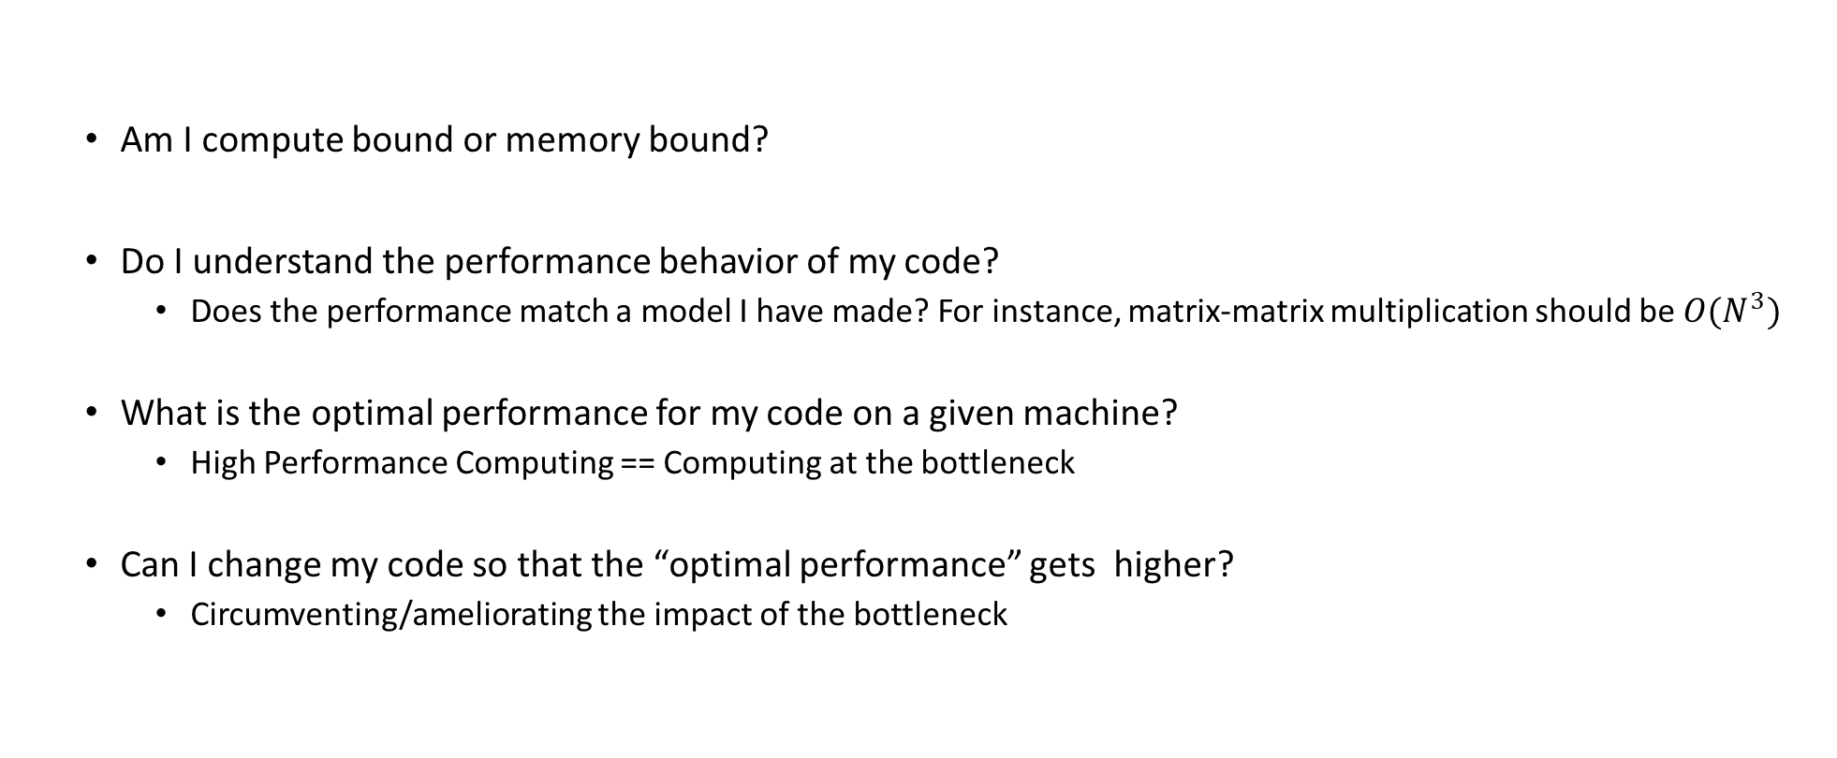
High Performance Computing: Questions to Ask
Am I compute bound or memory bound?
Do I understand the performance behavior of my code?
Does the performance match a model I have made? For instance, matrix-matrix multiplication should be ${O(N}^{3})$
What is the optimal performance for my code on a given machine?
High Performance Computing == Computing at the bottleneck
Can I change my code so that the “optimal performance” gets higher?
Circumventing/ameliorating the impact of the bottleneck

Slide 14
Outside the scope of course: The roofline model
I encourage you to read about the “roofline model” to assess code performance
“Are you compute bound?” ; “Am I memory bound?” ; “What chip/architecture might help me?”
Access here “roofline model” material from Supercomputing 2019

Slide 15
Let’s talk next about the compiler…
When you time/profile your code, you’ll have to play with the compile flags
Execution speed impacted heavily by compiling flags (3-4X speedup)
NOTE: Aggressive optimization done by compiler might change behavior of your code
Might change results
Might uncover skeletons in the closet
Side note: fair run-time comparisons is tricky
Different compilers have different flags
Tons of compilers out there: gcc, clang, g++, icl, cl, xl, etc.
Some compilers very adept at leveraging the underlying processor

Slide 16
How compilers come into play
A compiler has a tough job
Register allocation
Instruction selection and ordering
Dead code elimination
Fix minor inefficiencies
The expectation is that the compiler will provide an efficient mapping of program to machine
Compilers may or may not support features that have been included in a language recently (C++11, C++14, C++17, C++20, C++23, etc.)
Something to think about:
At least in theory, Intel compiler ought to be best positioned when it comes to compiling code for Intel chips
It ought to know all the dark corners of the microarchitecture
Well positioned to first implement any new/exotic ISA features

Slide 17
How compilers come into play
Compilers don’t improve asymptotic efficiency of your algorithm
Up to programmer to select the right algorithm for the problem & the architecture
Compilers have difficulty overcoming “optimization blockers”
Potential memory aliasing
“function call” side-effects

Slide 18
The compiler has a tough job
Often, compiler ends up doing analysis only at the function level
Newer versions of gcc do inter-procedural analysis within individual files
Whole-program analysis for some reason not done too often
More on this later
int functionFromOtherFile(double*);
double someOtherRemoteFunc(double*);
double myFunc() {
const size_t N = 1024;
double foo[N];
double accumulator = 0.;
for (int i = 0; i < functionFromOtherFile(foo); i++) {
accumulator += someOtherRemoteFunc(foo);
}
return accumulator;
}
Compiler in a tough spot: function bodies are often hidden from call sites, compiler can only see their declaration

Slide 19
The compiler has a tough job
The compiler operates under tight constraints
It must obey all the rules in the C/C++ standard
Often prevents compiler from making optimizations that would only affect behavior under pathological conditions
Rule above possibly ignored though when your code is making use of nonstandard language features
This is what gets the compiler confused and it needs to play it super safe so that you are not mad at it
Behavior that may be obvious to the programmer can be obfuscated by coding styles and poor understanding of the language
Use of pointers is a big stumbling block (see more in 10 slides)

Slide 20
The compiler has a tough job
Most analysis based only on static information
Compiler can’t anticipate run-time inputs (in general)
One way in which we don’t help compilers is by writing code that is ambiguous, open to interpretation
The compilers can’t read our minds
When in doubt, the compiler must be conservative

Slide 21
Tricks of the trade, done by compiler
Function inlining – this is a big one
Wherever you call a function, the compiler simply replaces the call to function foo with the entire body of function foo (the entire function body dropped in)
Not always possible, you must explicitly call for it (by function decoration and/or compile flags)
Nowadays you can ask the compiler to report back what functions it successfully inlined
Consequences, if you can inline:
You have one less jump
More important: the compiler sees way more code and therefore engages in more fruitful optimizations
It’s one thing to optimize when you have 5 lines of code, and a different one for 500 lines of code
[Matt Godbolt]$→$

Slide 22
Other tricks of the trade, done by compiler
Constant propagation
Compiler substitutes all references to myApplePie with the constant value
Common subexpression elimination
Dead code removal
There may be areas of the code that have no effect on the output, and these can be removed
This includes loads and stores whose values are unused, as well as entire functions and expressions
Tail call removal
Set of recursive calls to same function get replaced by a loop
const double myApplePie = 3.1415;

Slide 23
How can you help the compiler?
A) Allow it to see as much code as possible
You set it free, so to speak
Recall that typically compiler sees only one file at a time
Can’t peek at some function you use that is defined in a different file
B) Provide flags to convey to it information
E.g.: telling compiler your target architecture can help quite a lot

Slide 24
Compilers, and link time optimization (LTO)
Compilers are becoming faster and smarter
It’s affordable and profitable to do program-level, not function level optimization
LTO (also known as LTCG, for “link time code generation”) can be used to allow the compiler to see across translation unit boundaries
Likely to provide good speed up for complex codes with many source files

Slide 25
LTO: Done how?
Individual translation units are compiled to an intermediate form instead of machine code
During the link process—when the entire program is visible—machine code is generated
The compiler can take advantage of this to inline across translation units, or at least use information about the side effects of called functions to optimize
NOTE: Invoking LTO can be done today; controlled through compile flags

Slide 26
Other tricks pulled off by the compiler [called “strength reduction”]
for (int i = 0; i < 100; ++i)
{
func(i * 1234);
}
You wrote this:
This is what the compiler will generate on your behalf:
for (int iTimes1234 = 0; iTimes1234 < 100 * 1234; i += 1234)
{
func(iTimes1234);
}
[Matt Godbolt]$→$

Slide 27
Other lesser trick: Share Common Subexpressions
Reuse portions of expressions
GCC will take care of this for you with –O1 flag
/* Sum neighbors of i,j */
up = val[(i-1)*n + j ];
down = val[(i+1)*n + j ];
left = val[i*n + j-1];
right = val[i*n + j+1];
sum = up + down + left + right;
long inj = i*n + j;
up = val[inj - n];
down = val[inj + n];
left = val[inj - 1];
right = val[inj + 1];
sum = up + down + left + right;
Up
Down
Stencil Operations
Left
Right
3 multiplications: i*n, (i–1)*n, (i+1)*n
1 multiplication: i*n
leaq 1(%rsi), %rax # i+1
leaq -1(%rsi), %r8 # i-1
imulq %rcx, %rsi # i*n
imulq %rcx, %rax # (i+1)*n
imulq %rcx, %r8 # (i-1)*n
addq %rdx, %rsi # i*n+j
addq %rdx, %rax # (i+1)*n+j
addq %rdx, %r8 # (i-1)*n+j
imulq %rcx, %rsi # i*n
addq %rdx, %rsi # i*n+j
movq %rsi, %rax # i*n+j
subq %rcx, %rax # i*n+j-n
leaq (%rsi,%rcx), %rcx # i*n+j+n
[15-213 @ CMU]$→$

Slide 28
Other lesser tricks: Replace costly operations with simpler ones
Examples:
Compiler will use “shift” whenever you multiply by a power of 2
16*x --> x << 4
Do not do this yourself, let the compiler do it, since it’s machine dependent
Compiler will go to great lengths to avoid divisions of integers
Around 20 times slower than an addition, and 5 times more expensive than multiplication
Division by power of 2 is simple (shift the other way, let the compiler do it)
Here’s a divide by 3, there is no division, actually:
divideByThree(unsigned int):
mov eax, edi ; eax = edi
mov edi, 2863311531 ; edi = 0xaaaaaaab
imul rax, rdi ; rax = rax * 0xaaaaaaab
shr rax, 33 ; rax >>= 33
ret
unsigned divideByThree(unsigned x){
return x / 3;
}
Computes 0.33333333337213844 of the input
[Matt Godbolt]$→$

Slide 29
One common theme for speeding up code: code motion
Code Motion
Reduce frequency with which some computation is performed
Particularly rewarding when a piece of code can get moved out of a loop
Typically done by the compiler, under higher optimization levels – if this is possible (more later)
Caveat: Make sure the new code produces same result (if you, rather than the compiler goes for it)
Code motion, basic idea, captured in this code snippet:
void set_row(double *a, double *b, int i, int n) {
for (int j = 0; j < n; j++)
a[n*i + j] = b[j];
}
void set_row(double *a, double *b, int i, int n) {
int dummy = n * i;
for (int j = 0; j < n; j++)
a[dummy + j] = b[j];
}
Typically done by compiler, if no red flags encountered

Slide 30
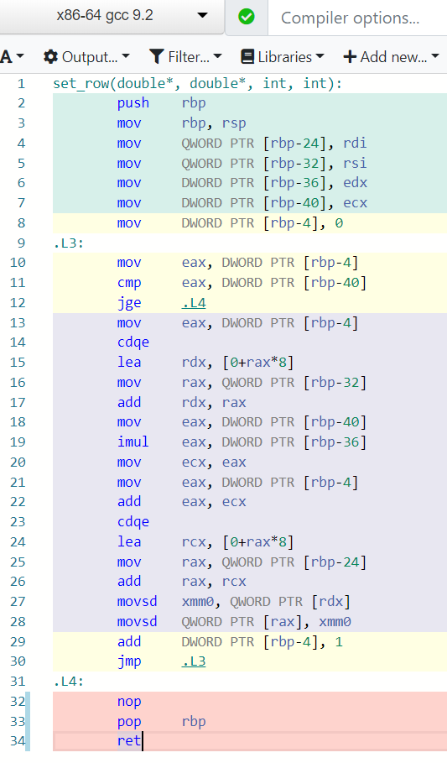
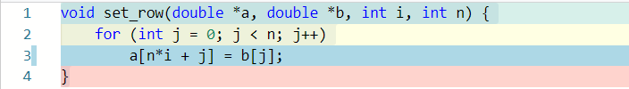

Assembly code, no optimization
See line 3 (left) and line 19 (right)
[https://godbolt.org/]$→$

Slide 31
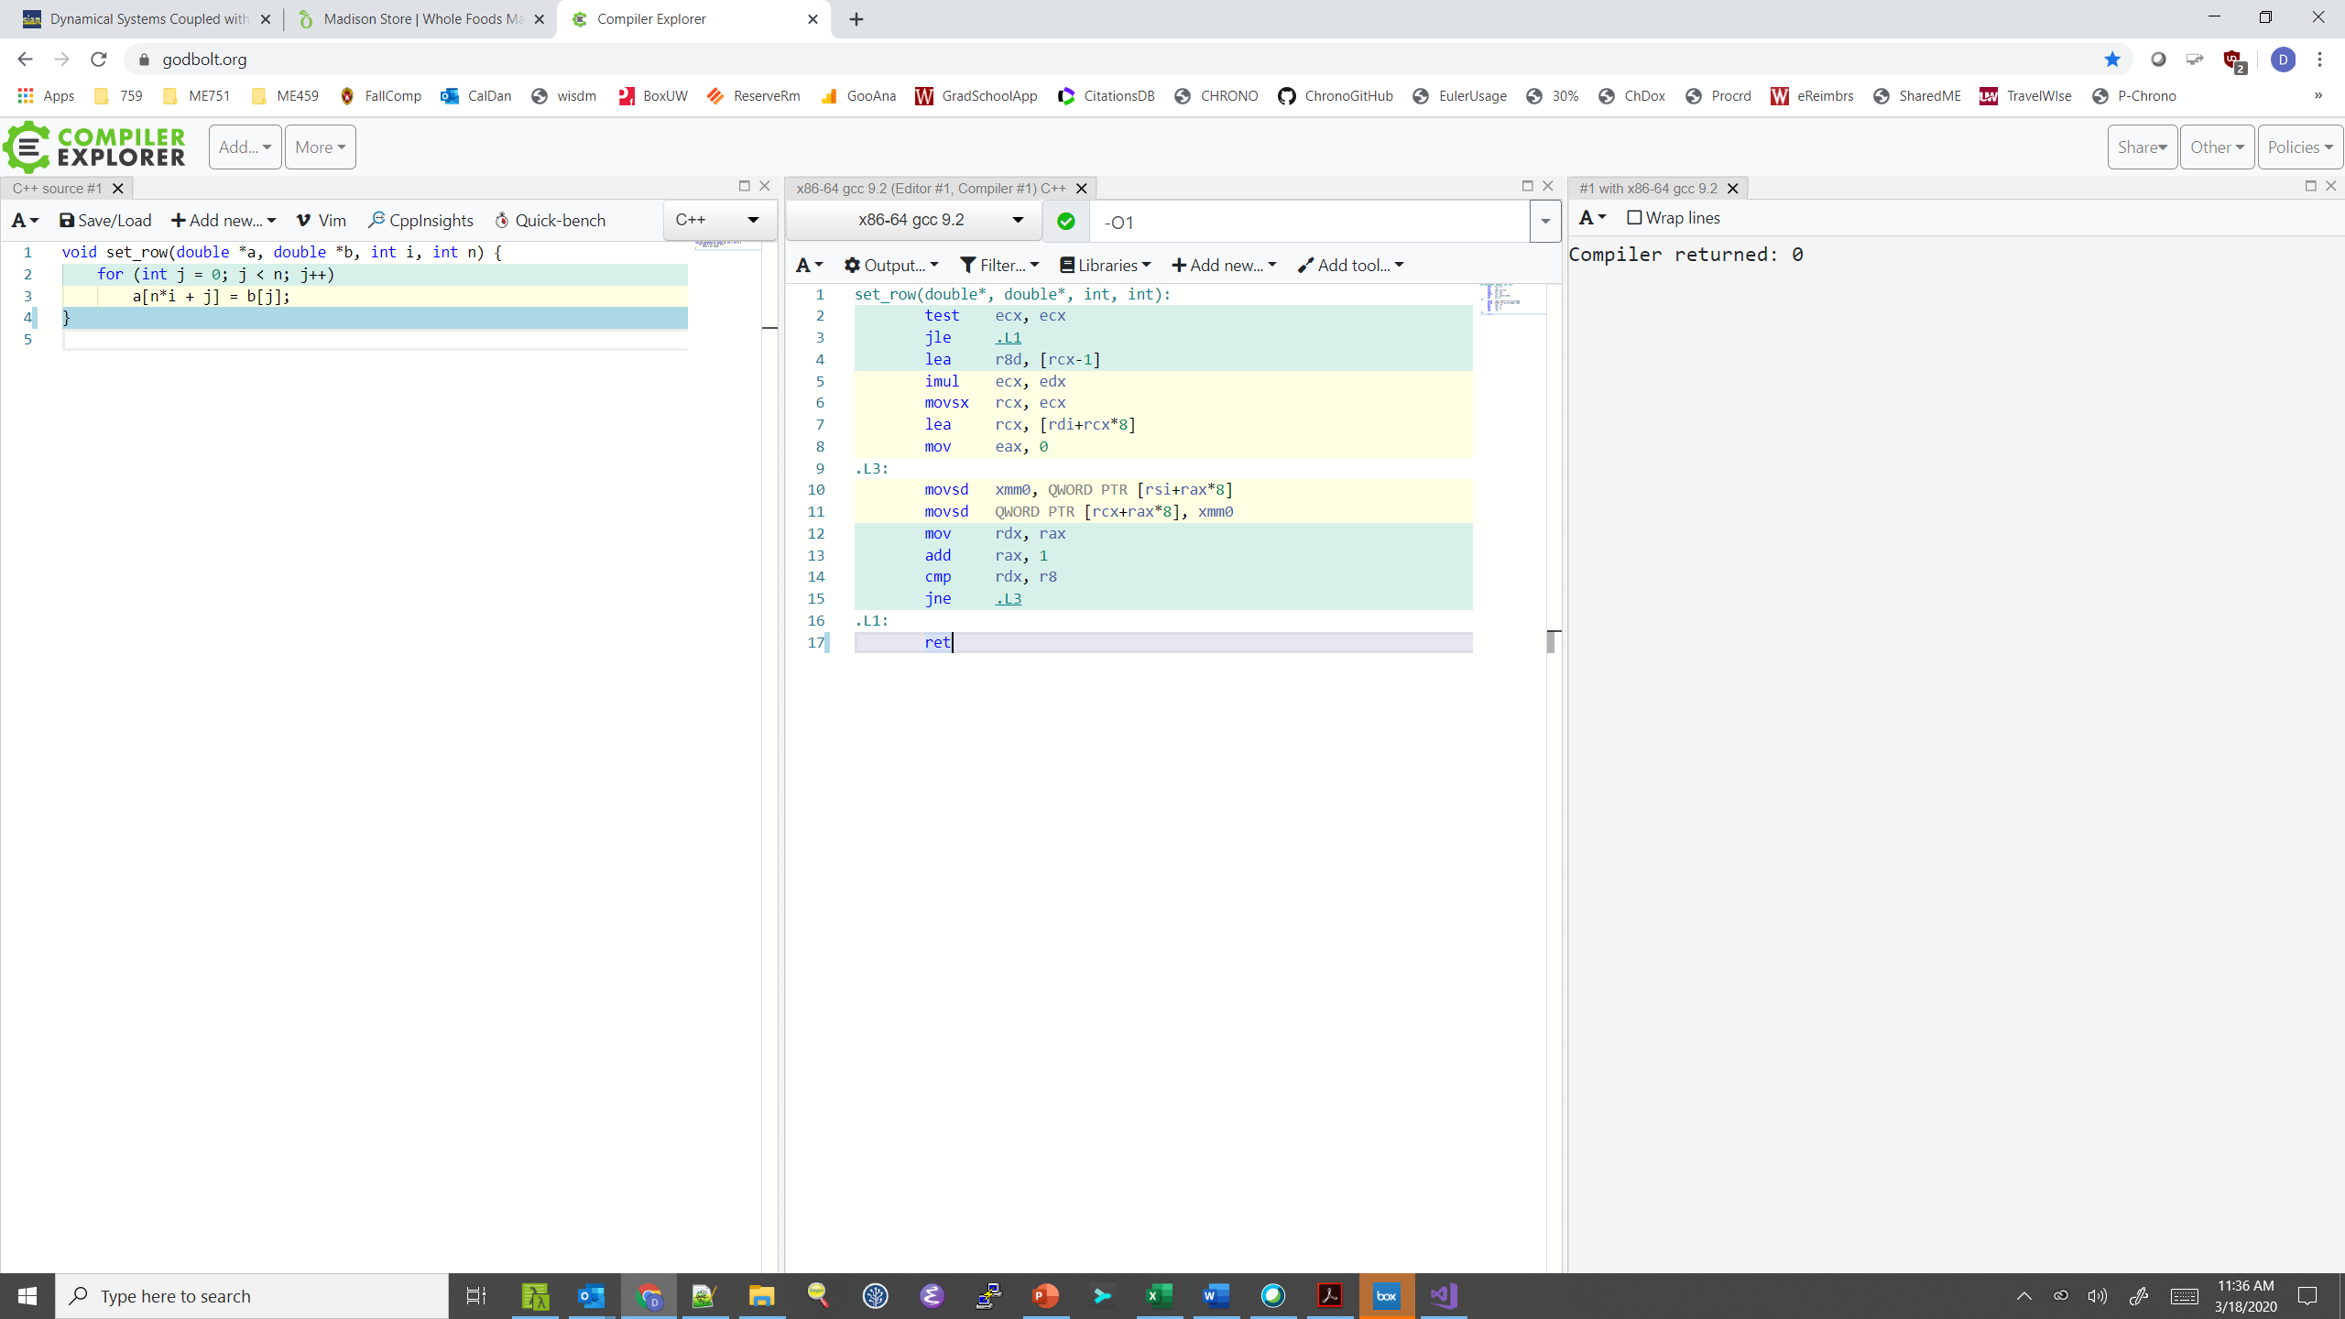
Assembly code, optimization –O1
Multiplication moved out of loop by compiler!
Bring b[j] into xmm0
Move xmm0 into a
Move value of j into rdx
Take home message: the compiler is your friend
Increment rax; i.e., j, by 1
Compare j with n (in r8)
Jump to .L3 if not equal
[https://godbolt.org/]$→$

Slide 32
[Next thing to consider:] Function calls are optimization blockers
Procedure to Convert String to Lower Case
void lower(char *s)
{
size_t i;
for (i = 0; i < strlen(s); i++)
if (s[i] >= 'A' && s[i] <= 'Z')
s[i] -= ('A' - 'a');
}
[15-213 @ CMU]$→$

Slide 33

Calling strlen
strlen performance
Only way to determine length of string is to scan its entire length, looking for null ‘\0’ character
We have N calls to strlen. What’s the impact?
Each call runs loop over N elements to find ‘\0’
Impact: Overall, O(N²) performance
/* My version of strlen */
size_t strlen(const char *s)
{
size_t length = 0;
while (*s != '\0') {
s++;
length++;
}
return length;
}
[15-213 @ CMU]$→$

Slide 34
Lower Case Conversion Performance: version V1
Time quadruples when double string length
Quadratic performance
lowerV1
[15-213 @ CMU]$→$

Slide 35
Improving Performance
Move call to strlen outside of loop
Note that you know that the length len does not change from one iteration to another
You took it upon yourself to perform “code motion”
void lower(char *s)
{
size_t i;
size_t len = strlen(s);
for (i = 0; i < len; i++)
if (s[i] >= 'A' && s[i] <= 'Z')
s[i] -= ('A' - 'a');
}
[15-213 @ CMU]$→$

Slide 36
Lower Case Conversion Performance: version V2
Time doubles when double string length
Linear performance of lower2
lowerV1
lowerV2
[15-213 @ CMU]$→$

Slide 37
Optimization Blocker: Procedure Calls
This, and nothing more, is the content of a file in which your strlen function is defined
Why couldn’t compiler move strlen out of inner loop?
A function might have side effects
e.g., alters global state each time called
Function might not return same value for given arguments
e.g., depends on global state (for instance, in multi-core parallelism)
The takeaway message
Compiler must treat procedure call as a black box
Weak optimizations near/around procedure call (stumbling block)
Compiler cannot read your mind; it does exactly what you told it to do
Possible remedies:
Try to do your own code motion (you should know if it’s safe or not)
C++: Use of inline functions
GCC does this with –O1
Within single file
Use LTO (more on this later)
static size_t lencnt = 0;
size_t strlen(const char *s)
{
size_t length = 0;
while (*s != '\0') {
s++; length++;
}
lencnt += length;
return length;
}
In this example, each time this strlen is called a variable is incremented (cooked up, but makes a point)
[15-213 @ CMU]$→$

Slide 38
[Next thing to consider:] Memory matters, and the trickiness of pointers
// sum entries in each row of A and store in vector b
void sum_rows1(double *A, double *b, long n) {
long i, j;
for (i = 0; i < n; i++) {
b[i] = 0;
for (j = 0; j < n; j++)
b[i] += A[i*n + j];
}
}
Assembly code, sum_rows1, inner loop (after j)
(gcc, optimized w/ -O1, from https://godbolt.org/)
.L3:
movsd xmm0, QWORD PTR [rdx]
addsd xmm0, QWORD PTR [rax]
movsd QWORD PTR [rdx], xmm0
add rax, 8
cmp rax, rcx
jne .L3
Bring b[i] from memory into register xmm0
Add to register xmm0 the right A entry from memory
Move updated b[i] value back into memory
Make rax have the address to next entry in A (double takes 8 bytes)
Compare i with n (latter stored in rcx)
Jump to .L3 if not equal
Code updates b[i] on every iteration
Why couldn’t compiler optimize this away?

Slide 39
Memory Aliasing
A,9 | 0x000000ff3a8ffc60 | double[9]
[0] | 0 | double
[1] | 1 | double
[2] | 2 | double
[3] | 3 | double
[4] | 22 | double
[5] | 224 | double
[6] | 32 | double
[7] | 64 | double
[8] | 128 | double
b,3 | 0x000000ff3a8ffc78 | double[3]
[0] | 3 | double
[1] | 22 | double
[2] | 224 | double
#include <stdlib.h>
/* Sum rows of n X n matrix A and store in vector b */
void sum_rows1(double *A, double *b, long n) {
long i, j;
for (i = 0; i < n; i++) {
b[i] = 0;
for (j = 0; j < n; j++)
b[i] += A[i * n + j];
}
}
double A[9] =
{ 0, 1, 2,
0, 8, 16},
32, 64, 128};
double A[9] =
{ 0, 1, 2,
0, 8, 16},
32, 64, 128};
double A[9] =
{ 0, 1, 2,
1, 8, 16},
32, 64, 128};
double A[9] =
{ 0, 1, 2,
3, 8, 16},
32, 64, 128};
double A[9] =
{ 0, 1, 2,
3, 0, 16},
32, 64, 128};
double A[9] =
{ 0, 1, 2,
3, 3, 16},
32, 64, 128};
double A[9] =
{ 0, 1, 2,
3, 6, 16},
32, 64, 128};
double A[9] =
{ 0, 1, 2,
3, 22, 16},
32, 64, 128};
double A[9] =
{ 0, 1, 2,
3, 22, 0},
32, 64, 128};
double A[9] =
{ 0, 1, 2,
3, 22, 32},
32, 64, 128};
double A[9] =
{ 0, 1, 2,
3, 22, 96},
32, 64, 128};
double A[9] =
{ 0, 1, 2,
3, 22, 224},
32, 64, 128};
Value of b:
int main() {
double A[9] = {0, 1, 2, 4, 8, 16, 32, 64, 128};
double *b;
b = A + 3;
sum_rows1(A, b, 3);
return 0;
}
init: [4, 8, 16]
i = 0: [3, 8, 16]
i = 1: [3, 22, 16]
i = 2: [3, 22, 224]
The code updates b[i] on every iteration. It does so because:
Must consider possibility that these updates will affect program behavior
Value of “b” might change from when i=3 to when i=4 (parallel thread might interfere)
[15-213 @ CMU]$→$

Slide 40
Removing Aliasing
Assume that there is no aliasing
That is, no monkey business in main driver
You can do code motion
Result: Accessing array b only once!!!
Number of instructions drops down
Performance goes up
/* Sum rows of n X n matrix A and store in vector b */
void sum_rows2(double *A, double *b, long n) {
long i, j;
for (i = 0; i < n; i++) {
double val = 0;
for (j = 0; j < n; j++)
val += A[i*n + j];
b[i] = val;
}
}
Assembly code, sum_rows2, inner loop (after j)
(gcc, optimized w/ -O2, from https://godbolt.org/)
.L3:
addsd xmm0, QWORD PTR [rax]
add rax, 8
cmp rax, rcx
jne .L3
Bring b[i] from memory and add to what’s in xmm0
Make rax point to next entry in row of A
Have you exhausted all entries in row “i” of A?
Jump back and do another trip if not more elems in row “i”

Slide 41
[Next thing to consider:] Memory Matters
.L3:
movsd xmm0, QWORD PTR [rdx]
addsd xmm0, QWORD PTR [rax]
movsd QWORD PTR [rdx], xmm0
add rax, 8
cmp rax, rcx
jne .L3
.L3:
addsd xmm0, QWORD PTR [rax]
add rax, 8
cmp rax, rcx
jne .L3
Bottom line: $→$ QWORD PTR shows up: three times (left) vs. one time (right)
That is, three vs. one memory accesses. Leads to significant speedup

Slide 42
Optimization Blocker: Memory Aliasing
Aliasing
Two different memory references specify single location
Easy to have happen in C - you have low level access to memory through pointers
Way around it:
Used local variables, like in the previous example – handy to accumulate within loops
You’ll help the compiler – it can issue better instructions
Use the restrict keyword, see code snippet
Feature added to the standard in 1999 (C99)
#include <stdlib.h>
/* Sum rows of n X n matrix A and store in vector b */
void sum_rows1(double * restrict A, double * restrict b, long n) {
long i, j;
for (i = 0; i < n; i++) {
b[i] = 0;
for (j = 0; j < n; j++)
b[i] += A[i * n + j];
}
}

Slide 43
New Example, w/ 2 actors – a struct + two functions
len
0
1
len-1
Our struct will use various Data Types
Use different declarations for data_t:
int
long
float
double
data
/* data structure for vectors */
typedef struct {
size_t len;
data_t *data;
} vec;
/* retrieve vector element and store in val */
void get_vec_element(*vec v, size_t idx, data_t *val) {
if (idx >= v->len || idx < 0)
*val = 0;
else
*val = v->data[idx];
}
The first function that comes into play
[15-213 @ CMU]$→$

Slide 44
Wrapping up the setup, for the new example
void combine1(vec_ptr v, data_t *dest) {
*dest = IDENT; // the identity value for OP
for (int i = 0; i < vec_length(v); i++) {
data_t val;
get_vec_element(v, i, &val);
*dest = *dest OP val;
}
}
Compute sum or product of vector elements (based on OP)
The second function that comes into play
Data Types
Use different declarations for data_t
int
long
float
double
Operations (OP)
Use different definitions of OP and IDENT
“+” : 0
“*” : 1
[15-213 @ CMU]$→$

Slide 45
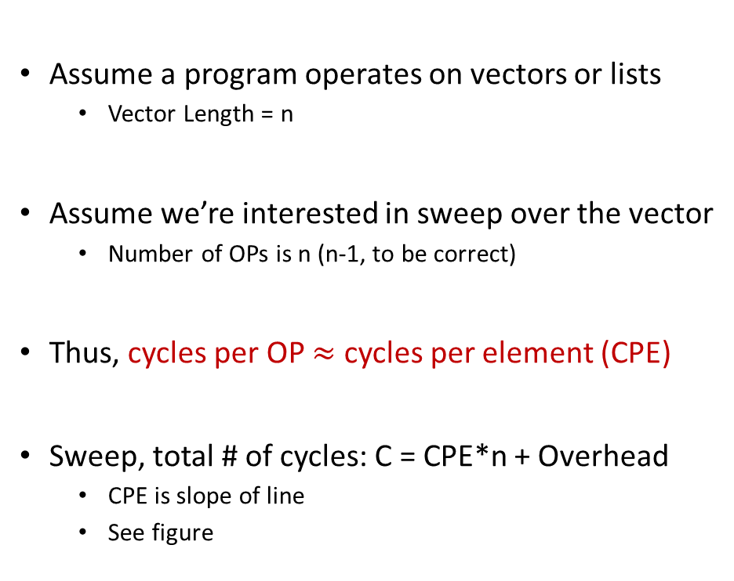
Cycles Per Element (CPE)
Assume a program operates on vectors or lists
Vector Length = n
Assume we’re interested in sweep over the vector
Number of OPs is n (n-1, to be correct)
Thus, cycles per OP $≈$ cycles per element (CPE)
Sweep, total # of cycles: C = CPE*n + Overhead
CPE is slope of line
See figure
psum1
Slope = 9.0
psum2
Slope = 6.0
[15-213 @ CMU]$→$

Slide 46

Benchmark Performance
void combine1(vec_ptr v, data_t *dest) {
*dest = IDENT; // the identity value for OP
for (int i = 0; i < vec_length(v); i++) {
data_t val;
get_vec_element(v, i, &val);
*dest = *dest OP val;
}
}
Sweep to compute sum or product of vector elements
Results in CPE (cycles per element) – Smaller is BETTER!
Method | data_t: Integer |  | data_t: Double FP
Operation (OP) | add | mult | add | mult
combine1 unoptimized | 22.68 | 20.02 | 19.98 | 20.18
combine1 with –O1 | 10.12 | 10.12 | 10.17 | 11.14
combine1 with –O3 | 4.5 | 4.5 | 6 | 7.8
[15-213 @ CMU]$→$

Slide 47
Basic Optimizations
No function call here anymore
void combine4(vec_ptr v, data_t *dest) {
int length = vec_length(v);
data_t *d = get_vec_start(v);
data_t temp = IDENT;
for (int i = 0; i < length; i++)
temp = temp OP d[i];
*dest = temp;
}
Shortcut: you get the raw pointer, and index into it… No need to call get_vec_element
Modification #1: vec_length moved out of loop
One function call avoided at each iteration
Modification #2: bypassed get_vec_element call
Modification #3: Accumulate in temporary “temp”
[15-213 @ CMU]$→$

Slide 48
Effect of Basic Optimizations
void combine4(vec_ptr v, data_t *dest) {
int length = vec_length(v);
data_t *d = get_vec_start(v);
data_t temp = IDENT;
for (int i = 0; i < length; i++)
temp = temp OP d[i];
*dest = temp;
}
Method | Integer |  | Double FP
Operation | add | mult | add | mult
combine1 –O1 | 10.12 | 10.12 | 10.17 | 11.14
combine4 | 1.27 | 3.01 | 3.01 | 5.01
Eliminates overhead in loop & can do prefetching
[15-213 @ CMU]$→$

Slide 49
Opportunities for Efficiency Gains
Cluster (distributed mem.)
Group of nodes communicate through fast interconnect
MPI, Charm++, Chapel
Multi-Socket Node
Group of CPUs on the same node, talk through main mem.
OpenMP, MPI
Acceleration (GPU/Phi)
Compute devices accelerating parallel computation on one node
CUDA, OpenCL, OpenMP
Multi-Core Processor
Communication through shared caches and main mem.
OpenMP, TBB, pthreads
Vectorization
Higher operation throughput via special/fat registers
AVX, SSE
Pipelining
Sequence of instruction sharing functional units
Assembly
Superscalar
Non-sequence instructions sharing functional units
Assembly
We have full control →
We have little to no control →
Little, but might pack a punch!

Slide 50
[Next thing to consider:] Exploiting Instruction-Level Parallelism
Simple ILP-targeted transformations can yield good performance improvements
Compilers often cannot make these transformations since they don’t know if it’s safe to do so or not
ILP
Hardware can execute multiple instructions in parallel
Performance limited by ILP hazards

Slide 51
Curbing our enthusiasm, ILP hazards
Structural hazards
The scheduler: “Unfortunately, there aren’t enough hammers in this plant”
Data dependency hazards
The scheduler: “This next instruction depends on the outcome of the instruction right ahead of it”
Control hazards
The scheduler: “I’m not sure what is supposed to happen next”

Slide 52
Modern CPU Design [old slide]
Instruction Control
Fetch
Control
Address
Instruction
Cache
Retirement
Unit
Register
File
Instruction
Decode
Instructions
Operations
Register Updates
Prediction OK?
Execution
Functional
Units
Branch
Arith
Arith
Arith
Load
Store
Operation Results
Addr.
Addr.
Data
Data
Data
Cache
[15-213 @ CMU]$→$

Slide 53
Recall ILP discussion, 1.5 months ago: Superscalar Processor
Superscalar processor: one that can issue more than one instruction in one cycle. The instructions are retrieved from a sequential instruction stream and are usually scheduled dynamically
Superscalar solution: one manifestation of the instruction level parallelism idea
Note: Most modern CPUs are superscalar
Intel: since Pentium (1993)
[15-213 @ CMU]$→$

Slide 54
Pipelined Functional Units
Stage 1
int mult_example(int a, int b, int c) {
int p1 = a * b;
int p2 = a * c;
int p3 = p1 * p2;
return p3;
}
Stage 2
Stage 3
 | Time
 | 1 | 2 | 3 | 4 | 5 | 6 | 7
Stage 1 | a*b | a*c |  |  | p1*p2
Stage 2 |  | a*b | a*c |  |  | p1*p2
Stage 3 |  |  | a*b | a*c |  |  | p1*p2
Divide computation into stages
Pass partial computations from stage to stage
Stage s can start on new computation once values passed to s+1
E.g., complete 3 multiplications in 7 cycles, even though each requires 3 cycles
Note when p1*p2 is issued – classical data dependency situation

Slide 55
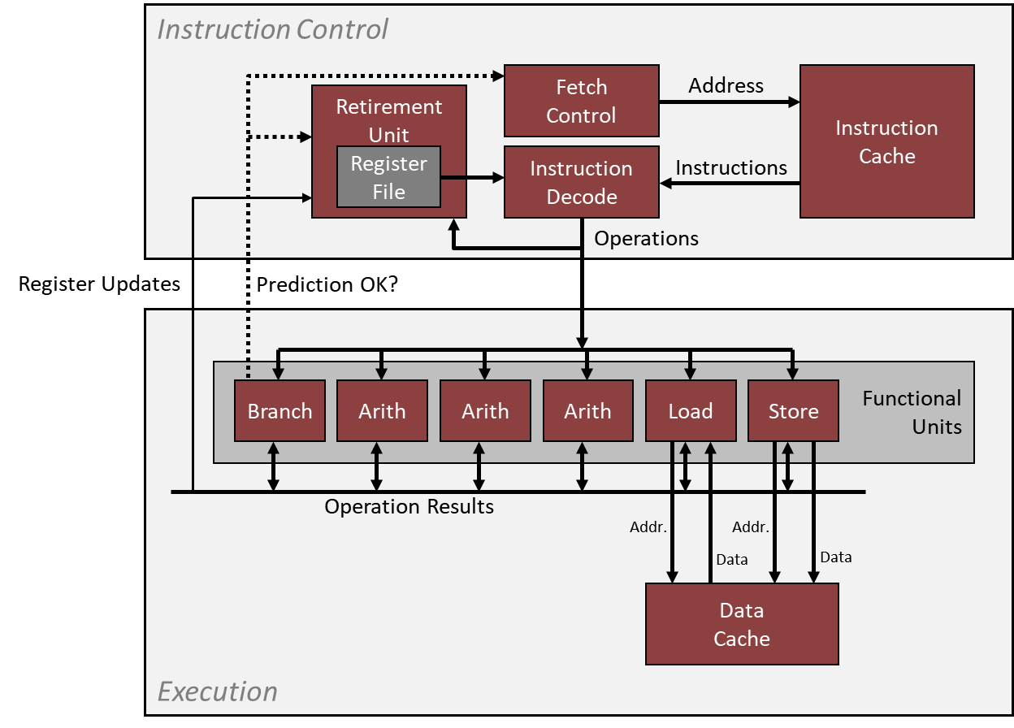
Example: The Intel Haswell CPU – aspects that are ILP relevant
Haswell: 8 Total Functional Units
Multiple instructions can execute in parallel
2 load, with address computation
1 store, with address computation
4 integer ops (doing address arithmetic too – explains why you have more)
2 FP multiply
1 FP add
1 FP divide
Some instructions take > 1 cycle, but can be pipelined
Instruction Latency, cycles Cycles/Issue
Load / Store 4 1
Integer Multiply 3 1
Integer Add 1 1
Integer/Long Divide 3-30 3-30
Single/Double FP Multiply 5 1
Single/Double FP Add 3 1
Single/Double FP Divide 3-15 3-15
For this type of info: see Agner Fog's optimization manual (part of “ME759 assigned reading” list)
[15-213 @ CMU]$→$

Slide 56
x86-64 Compilation of combine4 function
Inner Loop (Case: Integer Multiply)
.L519: # Loop:
imull (%rax,%rdx,4), %ecx # t = t * d[i]
addq $1, %rdx # i++
cmpq %rdx, %rbp # Compare length:i
jg .L519 # If >, goto Loop
Method | Integer |  | Double FP
Operation | add | mult | add | mult
combine4 | 1.27 | 3.01 | 3.01 | 5.01
Latency Bound | 1.00 | 3.00 | 3.00 | 5.00
[15-213 @ CMU]$→$

Slide 57

combine4 = Serial Computation
Assume OP $≡$ multiplication ($∗$)
1
d₀
Computation, assume length=8:
((((((((1 * d[0]) * d[1]) * d[2]) * d[3]) * d[4]) * d[5]) * d[6]) * d[7])
You have sequential dependence
Performance: determined by latency of OP
*
d₁
*
d₂
*
d₃
*
d₄
*
d₅
*
d₆
*
d₇
*
[15-213 @ CMU]$→$

Slide 58
First trick: Loop Unrolling (2x1)
void unroll2a_combine(vec_ptr v, data_t *dest) {
int length = vec_length(v);
int limit = length - 1;
data_t *d = get_vec_start(v);
data_t x = IDENT;
int i;
// Combine 2 elements at a time
for (i = 0; i < limit; i += 2) {
x = (x OP d[i]) OP d[i + 1];
}
// Finish any remaining elements
for (; i < length; i++) {
x = x OP d[i];
}
*dest = x;
}
Perform 2x more useful work per iteration
[15-213 @ CMU]$→$

Slide 59
Effect of Loop Unrolling
Method | Integer |  | Double FP
Operation | add | mult | add | mult
combine4 | 1.27 | 3.01 | 3.01 | 5.01
unroll2a | 1.01 | 3.01 | 3.01 | 5.01
Latency Bound | 1.00 | 3.00 | 3.00 | 5.00
Helps integer add
Achieves latency bound
Others don’t improve. Why?
Still sequential dependency
x = (x OP d[i]) OP d[i+1];
[15-213 @ CMU]$→$

Slide 60
Loop Unrolling with Reassociation (2x1a)
void unroll2aa_combine(vec_ptr v, data_t *dest) {
int length = vec_length(v);
int limit = length - 1;
data_t *d = get_vec_start(v);
data_t x = IDENT;
int i;
/* Combine 2 elements at a time */
for (i = 0; i < limit; i += 2) {
x = x OP(d[i] OP d[i + 1]);
}
/* Finish any remaining elements */
for (; i < length; i++) {
x = x OP d[i];
}
*dest = x;
}
Compare to before
x = (x OP d[i]) OP d[i+1];
Can this change the result of the computation?
Yes, for FP. Why?
[15-213 @ CMU]$→$

Slide 61
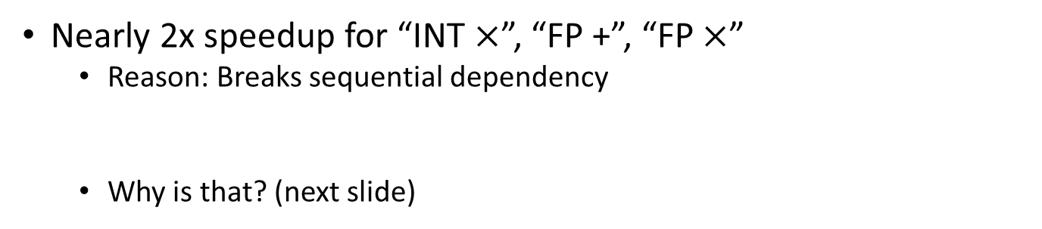
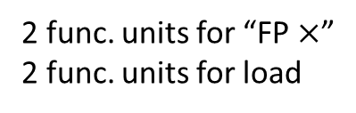
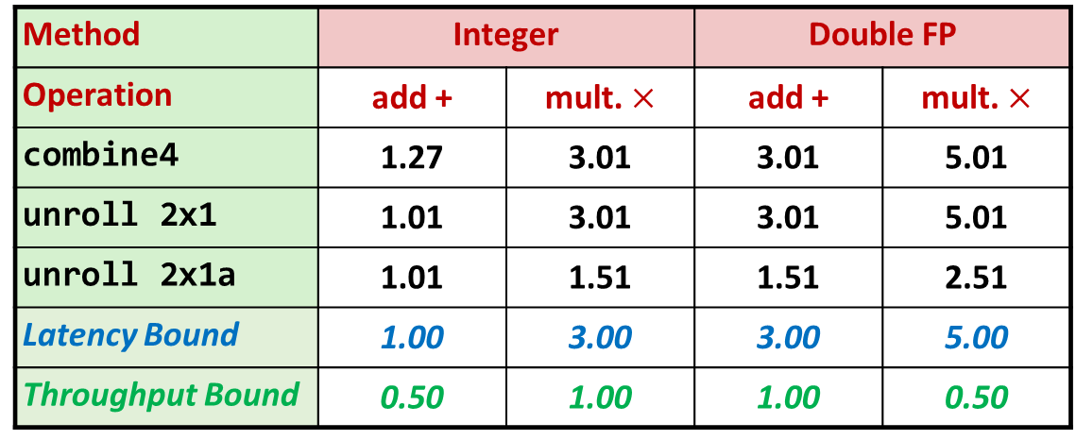
Effect of Reassociation
Method | Integer |  | Double FP
Operation | add + | mult. $×$ | add + | mult. $×$
combine4 | 1.27 | 3.01 | 3.01 | 5.01
unroll 2x1 | 1.01 | 3.01 | 3.01 | 5.01
unroll 2x1a | 1.01 | 1.51 | 1.51 | 2.51
Latency Bound | 1.00 | 3.00 | 3.00 | 5.00
Throughput Bound | 0.50 | 1.00 | 1.00 | 0.50
4 func. units for “INT +”
2 func. units for load
2 func. units for “FP $×$”
2 func. units for load
Nearly 2x speedup for “INT $×$”, “FP +”, “FP $×$”
Reason: Breaks sequential dependency
Why is that? (next slide)
x = x OP (d[i] OP d[i+1]);
[15-213 @ CMU]$→$

Slide 62
Reassociated Computation
x = x OP (d[i] OP d[i+1]);
What changed:
Ops in the next iteration can be started early (no dependency)
Prefetching kicks in
Overall Performance
N elements, D cycles latency/op
(N/2+1)*D cycles: CPE = D/2
d₀
d₁
*
d₂
d₃
1
*
d₄
d₅
*
*
d₆
d₇
*
*
*
*
[15-213 @ CMU]$→$

Slide 63
Loop Unrolling with Separate Accumulators (2x2)
void unroll2a_combine(vec_ptr v, data_t *dest) {
long length = vec_length(v);
long limit = length - 1;
data_t *d = get_vec_start(v);
data_t x0 = IDENT;
data_t x1 = IDENT;
long i;
// Combine 2 elements at a time
for (i = 0; i < limit; i += 2) {
x0 = x0 OP d[i];
x1 = x1 OP d[i + 1];
}
// Finish any remaining elements
for (; i < length; i++) {
x0 = x0 OP d[i];
}
*dest = x0 OP x1;
}
Different form of reassociation
[15-213 @ CMU]$→$

Slide 64
Effect of Separate Accumulators
Method | Integer |  | Double FP
Operation | Add | Mult | Add | Mult
Combine4 | 1.27 | 3.01 | 3.01 | 5.01
Unroll 2x1 | 1.01 | 3.01 | 3.01 | 5.01
Unroll 2x1a | 1.01 | 1.51 | 1.51 | 2.51
Unroll 2x2 | 0.81 | 1.51 | 1.51 | 2.51
Latency Bound | 1.00 | 3.00 | 3.00 | 5.00
Throughput Bound | 0.50 | 1.00 | 1.00 | 0.50
“INT +” makes use of two load units
2x speedup (over unroll2) for “INT *”, “FP +”, “FP *”
x0 = x0 OP d[i];
x1 = x1 OP d[i+1];
[15-213 @ CMU]$→$

Slide 65
Separate Accumulators
x0 = x0 OP d[i];
x1 = x1 OP d[i+1];
What changed:
Two independent “streams” of operations
Overall Performance
N elements, D cycles latency/op
Should be (N/2+1)*D cycles: CPE = D/2
CPE matches prediction!
1
d₀
1
d₁
*
d₂
*
d₃
*
d₄
*
d₅
*
d₆
*
d₇
*
*
What Now?
*
[15-213 @ CMU]$→$

Slide 66
Unrolling & Accumulating
Idea
Can unroll to any degree L
Can accumulate K results in parallel
L must be multiple of K
Limitations
Diminishing returns
Cannot go beyond throughput limitations of execution units
Large overhead for short lengths
Finish off iterations sequentially
[15-213 @ CMU]$→$

Slide 67
Unrolling & Accumulating: Floating Point Multiplication
Case
Intel Haswell
Double FP Multiplication
Latency bound: 5.00. Throughput bound: 0.50
FP * | Unrolling Factor L
K | 1 | 2 | 3 | 4 | 6 | 8 | 10 | 12
1 | 5.01 | 5.01 | 5.01 | 5.01 | 5.01 | 5.01 | 5.01
2 |  | 2.51 |  | 2.51 |  | 2.51
3 |  |  | 1.67
4 |  |  |  | 1.25 |  | 1.26
6 |  |  |  |  | 0.84 |  |  | 0.88
8 |  |  |  |  |  | 0.63
10 |  |  |  |  |  |  | 0.51
12 |  |  |  |  |  |  |  | 0.52
Accumulators
[15-213 @ CMU]$→$

Slide 68
Unrolling & Accumulating: Integer Addition
Case
Intel Haswell
Integer addition
Latency bound: 1.00. Throughput bound: 0.50
FP * | Unrolling Factor L
K | 1 | 2 | 3 | 4 | 6 | 8 | 10 | 12
1 | 1.27 | 1.01 | 1.01 | 1.01 | 1.01 | 1.01 | 1.01
2 |  | 0.81 |  | 0.69 |  | 0.54
3 |  |  | 0.74
4 |  |  |  | 0.69 |  | 1.24
6 |  |  |  |  | 0.56 |  |  | 0.56
8 |  |  |  |  |  | 0.54
10 |  |  |  |  |  |  | 0.54
12 |  |  |  |  |  |  |  | 0.56
Accumulators
[15-213 @ CMU]$→$

Slide 69
Achievable Performance
Method | Integer |  | Double FP
Operation | Add | Mult | Add | Mult
Best | 0.54 | 1.01 | 1.01 | 0.52
Latency Bound | 1.00 | 3.00 | 3.00 | 5.00
Throughput Bound | 0.50 | 1.00 | 1.00 | 0.50
Limited only by throughput of functional units
Up to 42X improvement over original, un-optimized code
[15-213 @ CMU]$→$

Slide 70
Programming with AVX2, YMM Registers related
16 total, each 32 bytes
32 single-byte integers
16 16-bit integers
8 32-bit integers
8 single-precision floats
4 double-precision floats
1 single-precision float
1 double-precision float
[15-213 @ CMU]$→$

Slide 71
SIMD Operations
SIMD Operations: Single Precision
SIMD Operations: Double Precision
vaddsd %ymm0, %ymm1, %ymm1
%ymm0
+
+
+
+
+
+
+
+
%ymm1
vaddpd %ymm0, %ymm1, %ymm1
%ymm0
+
+
+
+
%ymm1
[15-213 @ CMU]$→$

Slide 72
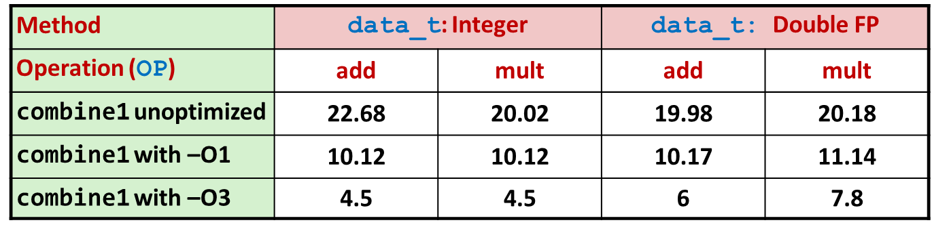
Using Vector Instructions
Method | Integer |  | Double FP
Operation | add | mult | add | mult
Scalar Best | 0.54 | 1.01 | 1.01 | 0.52
Vector Best | 0.06 | 0.24 | 0.25 | 0.16
Latency Bound | 0.50 | 3.00 | 3.00 | 5.00
Throughput Bound | 0.50 | 1.00 | 1.00 | 0.50
Vec Throughput Bound | 0.06 | 0.12 | 0.25 | 0.12
This is where we are now
Additional speedup owing to use of AVX Instructions
Parallel operations on multiple data elements
The “mips” in OpenMP
This is where we started
[15-213 @ CMU]$→$

Slide 73
Supplemental Material: Branch Prediction (another ILP trick)
Challenge
Instruction Control Unit must work ahead of Execution Unit to generate enough operations to keep EU busy
When encounters conditional branch, cannot reliably determine where to continue fetching
404663: mov $0x0,%eax
404668: cmp (%rdi),%rsi
40466b: jge 404685
40466d: mov 0x8(%rdi),%rax
. . .
404685: repz retq
Executing
How to continue?
[15-213 @ CMU]$→$

Slide 74
Modern CPU Design
Instruction Control
Fetch
Control
Address
Instruction
Cache
Retirement
Unit
Register
File
Instruction
Decode
Instructions
Operations
Register Updates
Prediction OK?
Execution
Functional
Units
Branch
Arith
Arith
Arith
Load
Store
Operation Results
Addr.
Addr.
Data
Data
Data
Cache
[15-213 @ CMU]$→$

Slide 75
Branch Outcomes
When encounter conditional branch, cannot determine where to continue fetching
Branch Taken: Transfer control to branch target
Branch Not-Taken: Continue with next instruction in sequence
Cannot resolve until outcome determined by branch/integer unit
404663: mov $0x0,%eax
404668: cmp (%rdi),%rsi
40466b: jge 404685
40466d: mov 0x8(%rdi),%rax
. . .
404685: repz retq
Branch Not-Taken
Branch Taken
[15-213 @ CMU]$→$

Slide 76
Branch Prediction
Idea
Guess which way branch will go
Begin executing instructions at predicted position
But don’t actually modify register or memory data (draws on RAT & ROB, see later)
404663: mov $0x0,%eax
404668: cmp (%rdi),%rsi
40466b: jge 404685
40466d: mov 0x8(%rdi),%rax
. . .
404685: repz retq
Predict Taken
Begin
Execution
[15-213 @ CMU]$→$

Slide 77
Branch Prediction Through Loop
401029: vmulsd (%rdx),%xmm0,%xmm0
40102d: add $0x8,%rdx
401031: cmp %rax,%rdx
401034: jne 401029
Assume
vector length = 100
i = 98
Predict Taken (OK)
401029: vmulsd (%rdx),%xmm0,%xmm0
40102d: add $0x8,%rdx
401031: cmp %rax,%rdx
401034: jne 401029
i = 99
Predict Taken
(Oops)
401029: vmulsd (%rdx),%xmm0,%xmm0
40102d: add $0x8,%rdx
401031: cmp %rax,%rdx
401034: jne 401029
Read invalid location
Executed
i = 100
401029: vmulsd (%rdx),%xmm0,%xmm0
40102d: add $0x8,%rdx
401031: cmp %rax,%rdx
401034: jne 401029
Fetched
i = 101
[15-213 @ CMU]$→$

Slide 78
Branch Misprediction Invalidation
401029: vmulsd (%rdx),%xmm0,%xmm0
40102d: add $0x8,%rdx
401031: cmp %rax,%rdx
401034: jne 401029
Assume
vector length = 100
i = 98
Predict Taken (OK)
401029: vmulsd (%rdx),%xmm0,%xmm0
40102d: add $0x8,%rdx
401031: cmp %rax,%rdx
401034: jne 401029
i = 99
Predict Taken
(Oops)
401029: vmulsd (%rdx),%xmm0,%xmm0
40102d: add $0x8,%rdx
401031: cmp %rax,%rdx
401034: jne 401029
i = 100
Invalidate
401029: vmulsd (%rdx),%xmm0,%xmm0
40102d: add $0x8,%rdx
401031: cmp %rax,%rdx
401034: jne 401029
i = 101
[15-213 @ CMU]$→$

Slide 79
Branch Misprediction Recovery
401029: vmulsd (%rdx),%xmm0,%xmm0
40102d: add $0x8,%rdx
401031: cmp %rax,%rdx
401034: jne 401029
401036: jmp 401040
. . .
401040: vmovsd %xmm0,(%r12)
i = 99
Definitely not taken
Reload
Pipeline
Performance Cost
Multiple clock cycles on modern processor
Can be a major performance limiter
[15-213 @ CMU]$→$

Slide 80
Branch Prediction Numbers
Default behavior:
Backwards branches are often loops so predict taken
Forwards branches are often if so predict not taken
Predictors average better than 95% accuracy
Most branches are already predictable.
Bonus material:
http://stackoverflow.com/questions/11227809/why-is-processing-a-sorted-array-faster-than-an-unsorted-array
[15-213 @ CMU]$→$

Slide 81
Short trip: actors, the “speculative execution” trick [it’s tricky]
“instruction issue phase” vs. “instruction retirement phase”: two different animals
ROB: reorder buffer
At issue time, an instruction is assigned an entry at the tail of the ROB. It’s there while in flight, before being committed
RAT: register alias table
RAT needed because of “register renaming”, which is a technique that abstracts logical registers from physical registers
Every logical register has a set of physical registers associated with it
The physical registers are opaque and cannot be referenced directly but only via the canonical names
The interplay between ROB and RAT allows an unwinding of the instructions without compromising the state of the program (since things were not committed yet)
Resources: see here and here, it takes 7 mins total.

Slide 82
Looking back at examples, what we did to improve performance
Used good compiler and the right flags
Helped the compiler get optimization going (use “restrict” keyword on pointer arguments)
Exploited instruction-level parallelism

